Slide 1
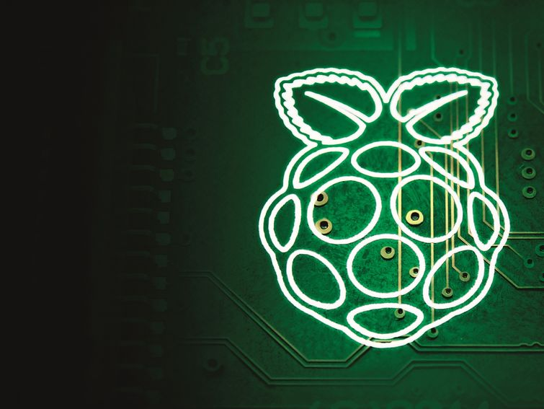


جامعة حلب
كلية الهندسة الإلكترونية والكهربائية
تصميم النظم الالكترونية
باستخدام لوحة Raspberry-Pi
إعداد: م.علا جزماتي

Slide 2
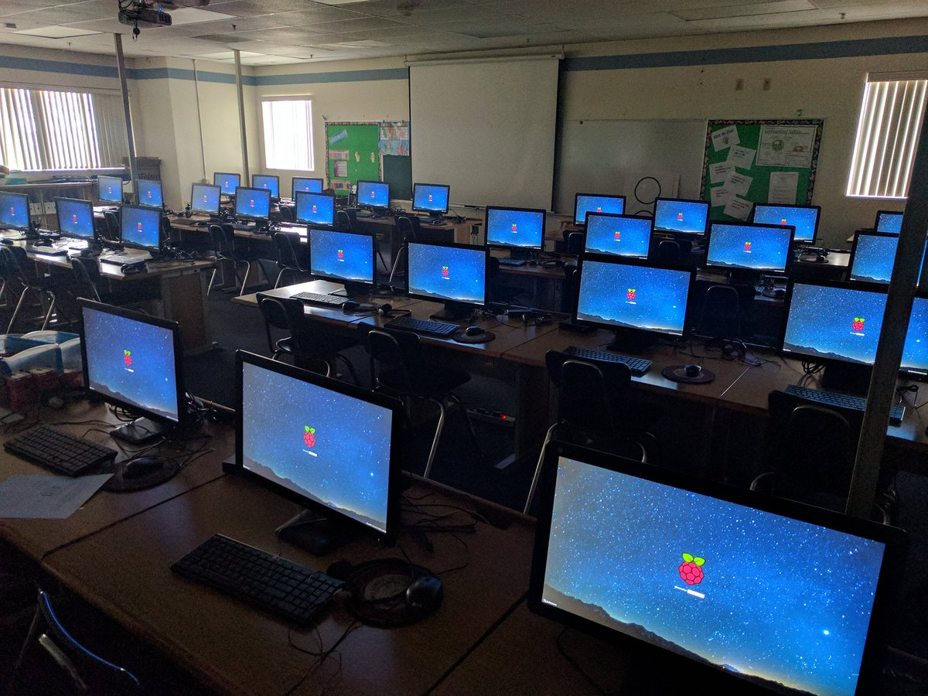

Slide 3
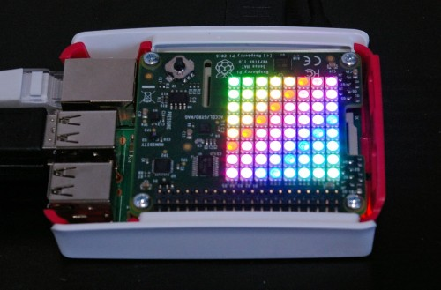
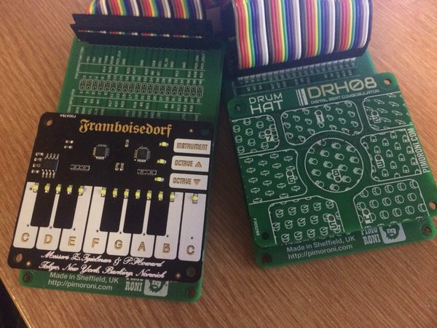
HAT
HAT ‘Hardware Attached on Top’

Slide 4
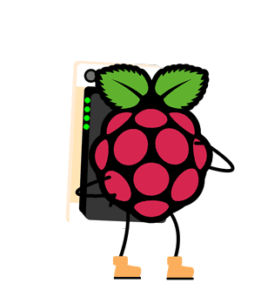
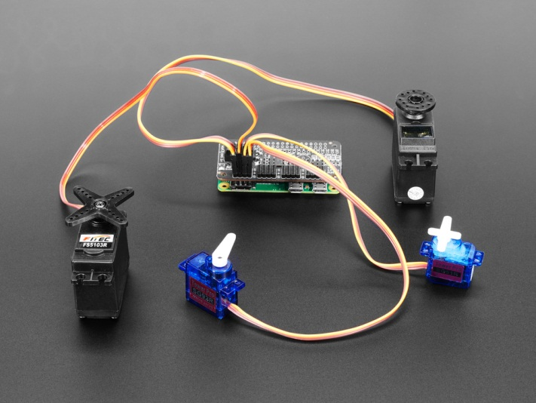
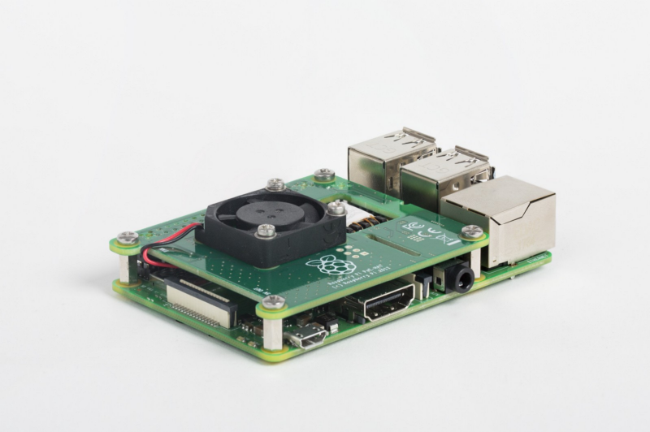
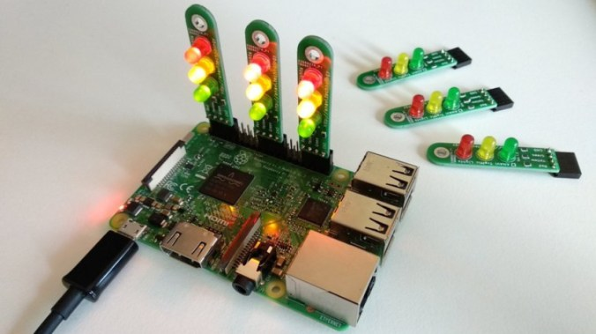
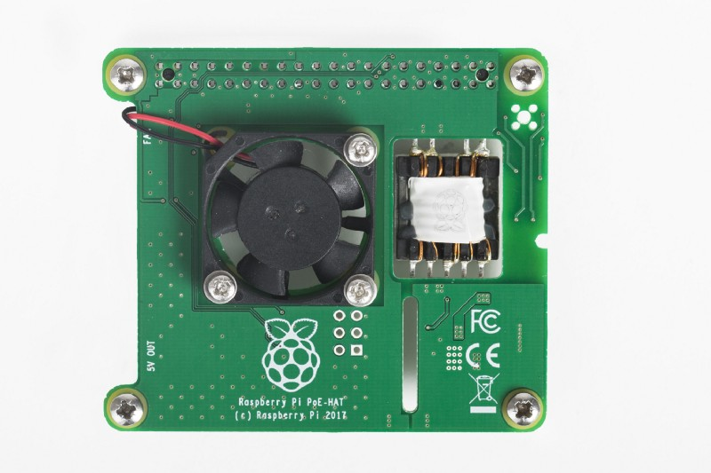
HAT

Slide 5
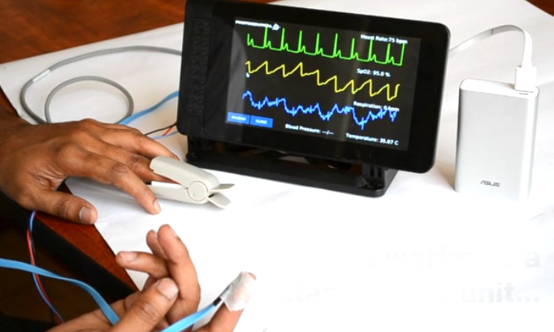
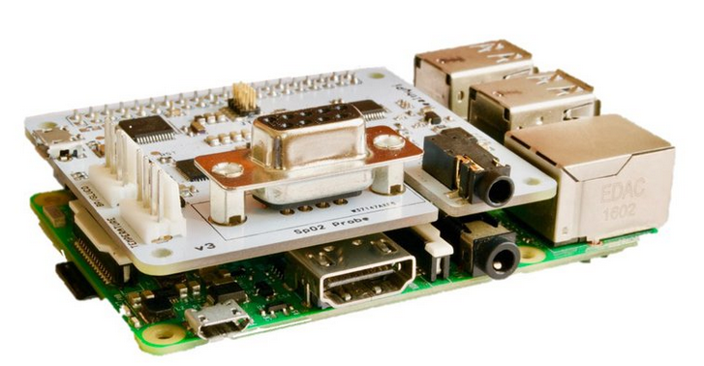
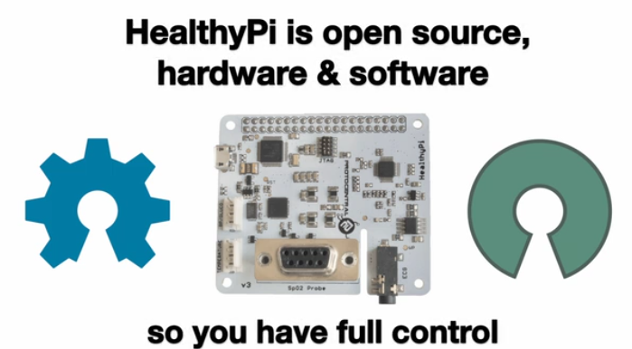
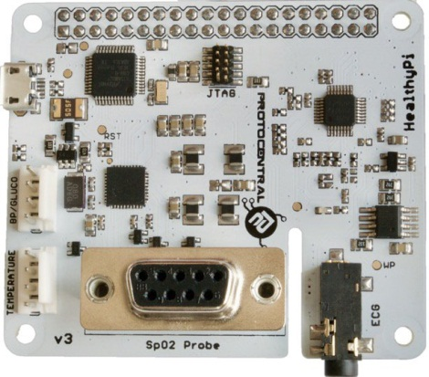
Healthy Pi HAT
Healthy Pi v3
An open-source, multi-parameter, full fledged human body vital sign monitoring HAT for Raspberry Pi as well as standalone use.
The basic kit includes the HealthyPi-v3 board plus temperature, pulse oximetry, and ECG/respiration sensors with 20 adhesive electrodes. Plug this board into your Raspberry Pi and touchscreen or use standalone through USB.
Notes:
https://www.crowdsupply.com/protocentral/healthypi-v3
Who Needs the HealthyPi?
If you are a student or researcher interested in incorporating human vital signs into your project, HealthyPi is easy to include in your research.
For regions of the world where medical care is limited and the cost of a conventional patient monitor is prohibitive, a simple patient monitoring system could mean saving a life. HealthyPi can work as that patient monitor.
If you are a medical device designer, HealthyPi is a useful prototyping device. If you like the results of a given prototype, you can simply take the module you developed (hardware and software files) and integrate it into your system with minimal guesswork.
Recording and streaming data from standard patient monitors is far from “standard” and in most cases requires proprietary software. HealthyPi uses open-source software which provides an easier off-the-shelf interface to your data. Better still, you can build your own custom functionality right into the software

Slide 6
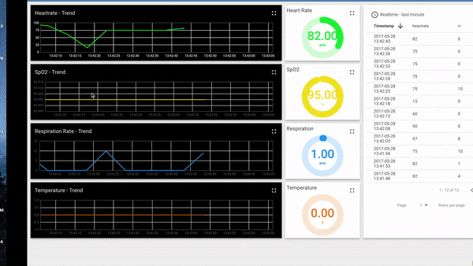
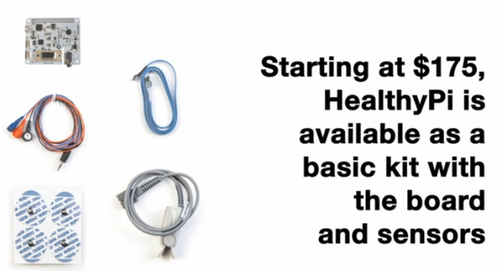
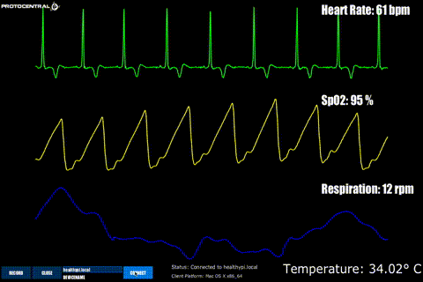
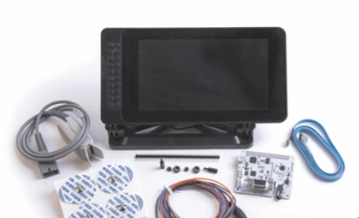
Healthy Pi HAT
Healthy Pi v3
An open-source, multi-parameter, full fledged human body vital sign monitoring HAT for Raspberry Pi as well as standalone use.
Notes:
https://www.crowdsupply.com/protocentral/healthypi-v3
Technical Specifications
An open-source, multi-parameter, full fledged human body vital sign monitoring HAT for Raspberry Pi as well as standalone use.
ECG and respiration front-End: Uses the TI ADS1292R 24-bit analog front-end with SNR of 107 dB
Pulse oximetry: Uses TI AFE4490 Pulse Oximetry front-end with integrated LED driver and 22-bit ADC
Temperature: Uses Maxim MAX30205 digital body temperature sensor for skin temperature sensing
Main microcontroller: Atmel ATSAMD21 ARM Cortex M0 - compatible with Arduino Zero
Programmability: Arduino Zero Bootloader preloaded
Interfaces: Raspberry Pi 40-pin header (UART pins connected), USB CDC device, extra UART connector provided for connecting an external blood pressure module
IoT functionality: Can use the Raspberry Pi’s Wi-Fi interface to communicate with a TCP client for telemedicine applications or using an MQTT client for continuous logging applications
GUI Compatibility: Uses processing Java-mode (compiles on MacOS/Windows/Linux/Linux-ARM platforms)
Firmware compatibility: Compiles with Arduino or Atmel Studio
Dimensions (board only): 65 mm x 56.5 mm x 6 mm
Weight: 100 g

Slide 7
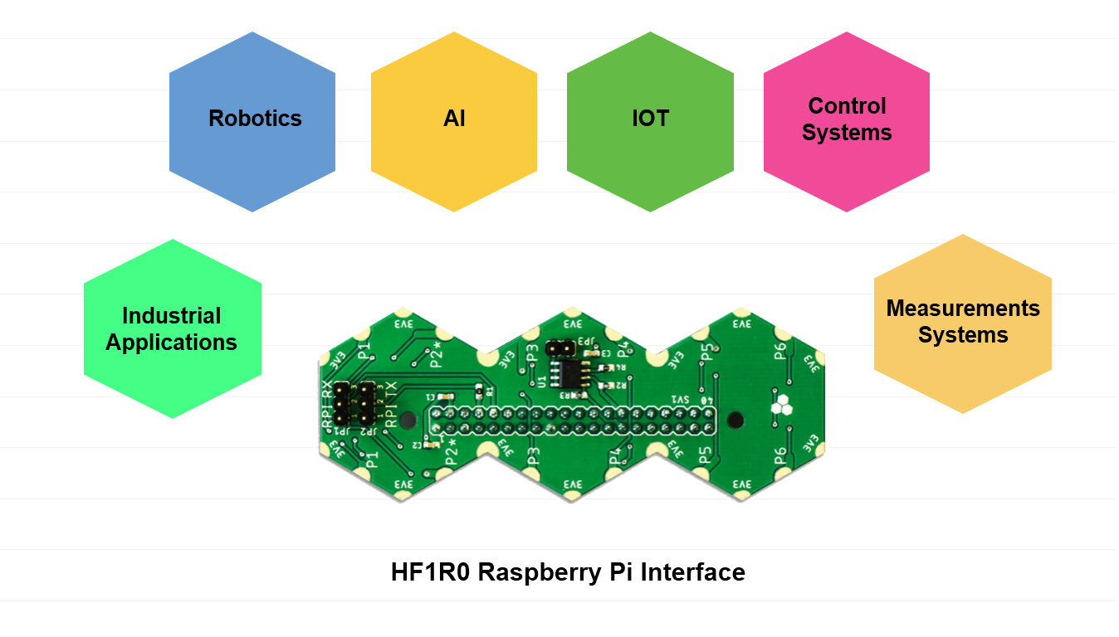
Hexabitz HAT

Slide 8
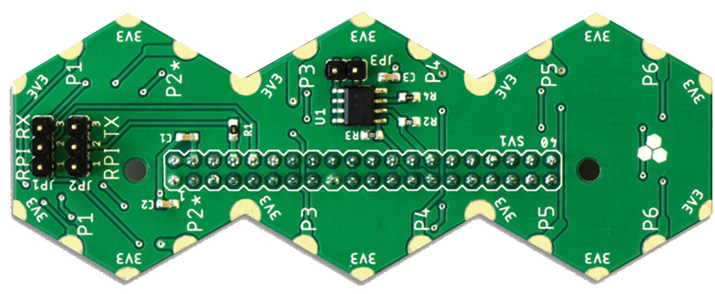
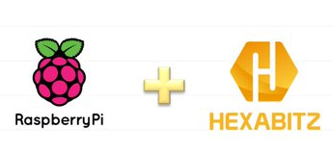
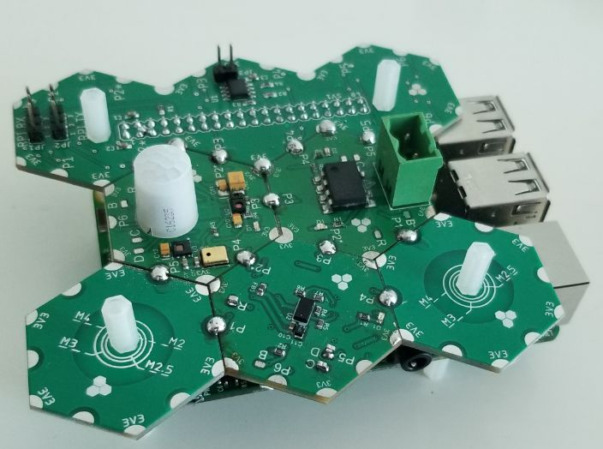
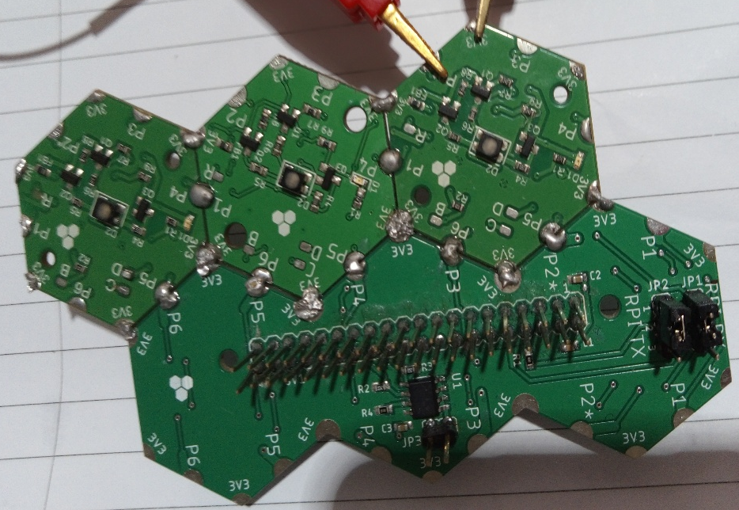
Hexabitz HAT

Slide 9
Pi HAT | الانطلاقة | إمكانية إضافة وظائف أو حساسات إضافية | لغة البرمجة
Sense HAT | صنعت من أجل مشروع AstroPi عام 2015 | لا يمكن | Python
Hexabitz HAT | عام 2019 يمكن استخدامها لبناء أنظمة مختلفة | يمكن | C++ Python
Healthy Pi HAT | عام 2017 تستخدم لاستحصال بعض الإشارات الحيوية | لا يمكن | Java
حاول أن تبحث عن نقاط أخرى للمقارنة..
أضف أنواع أخرى من Pi HAT وقارن بينها..

Slide 10
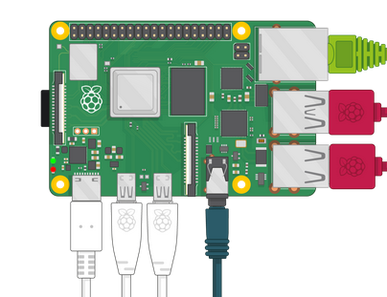

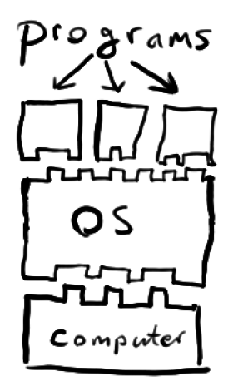
استخدام لوحة Raspberry Pi كحاسب شخصي
تهدف هذه المرحلة إلى التعرف على استخدام لوحة RaspberryPi كحاسب شخصي, حيث تتضمن التعرف على الملفات و المجلدات الأساسية داخل نظام لينكس وكيفية التعامل مع سطر الأوامر.

Slide 11

Command lines aren't the oldest way to tell a computer what to do. Depending on how you think of it, that distinction probably belongs to plugging wires into switchboards, toggling banks of switches, or moving beads on a wire
لمحة تاريخية

Slide 12
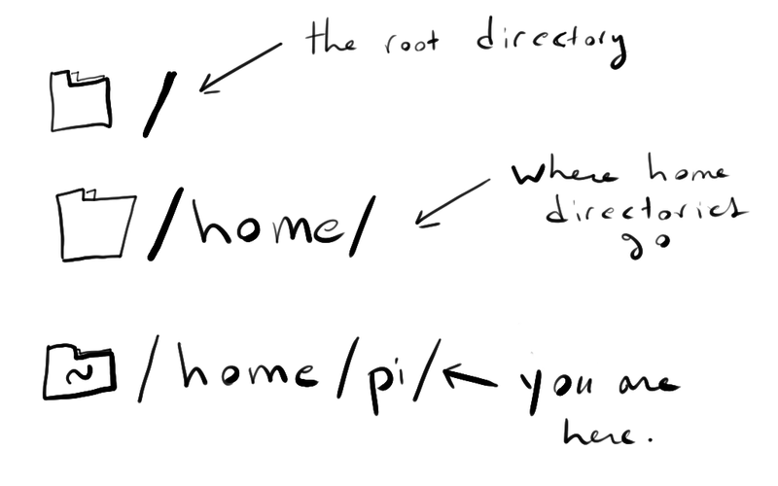
Notes:
Exploring the Machine
The shell is a lot like that game world, except that instead of a map full of rooms and objects, you navigate a computer'sfilesystem and work with the files it contains.
The filesystem, everything the operating system needs to boot up, run software, save files, take photos, etc. is organized intodirectories. We usually call these "folders" in the Windows and Macintosh worlds, but the concept is the same. A directory is just a special kind of file that can contain other files, including directories.

Slide 13

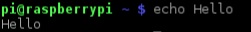
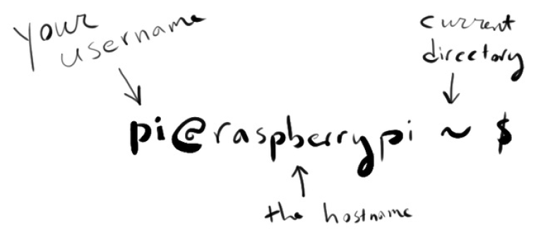
سطر الأوامر(Terminal)

Slide 14
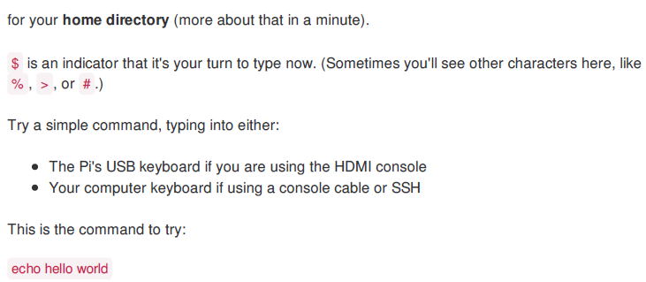
سطر الأوامر(Terminal)

Slide 15



Slide 16

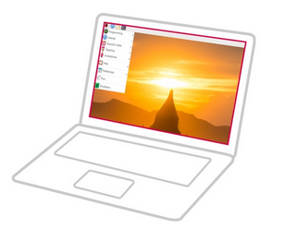


print working directory

Slide 17

ls is used to list files
Listing Files: ls
Notes:
As a user, you have a home directory. In the shell, ~ (the tilde) is a common shorthand for this. In this case, it points at /home/pi.
Log in to your Pi, acquire a terminal, and verify this:
pwd stands for print working directory. Commands in the Unix tradition tend to have short, cryptic names. Some can be easily remembered because they stand for something obvious. Others just have to be committed to memory.
If you have a look around your Pi, you'll find that it contains all sorts of stuff. You just need to know a few more commands. The following pages provide quick introductions to some of the basics.

Slide 18
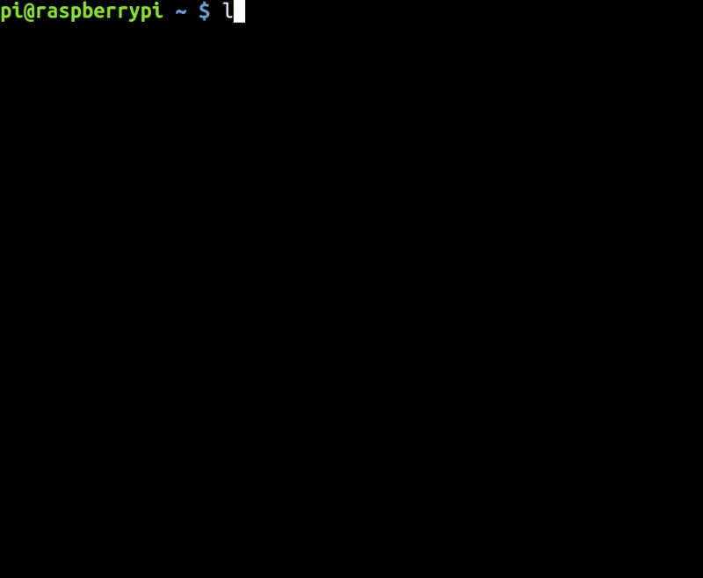
Notes:
ls is used to list files (note the first letter is the letter L not the number 1!)
Let's try it from our home directory:

Slide 19
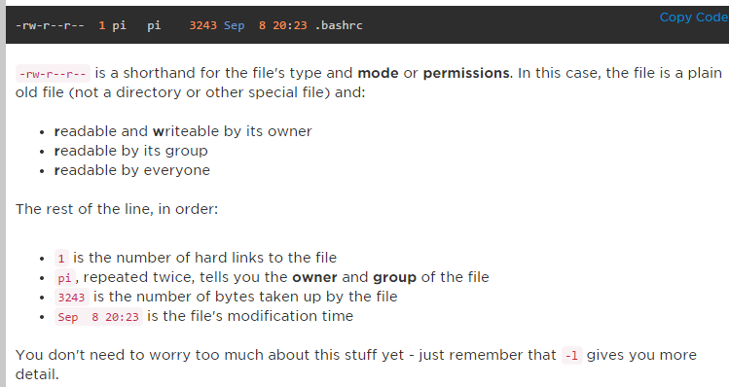
The -l option, for a long listing, will give you several columns of useful data. For the file called.bashrc, you have:
-rw-r--r-- 1 pi pi 3243 Sep 8 20:23 .bashrc
Notes:
Notice that second command and its output?
ls -a shows all the files in a directory, including hidden ones. Why are there hidden files? Because in the Unix world, all directories contain two special sub-directories:
. points to the current directory - /home/pi is the same as /home/pi/.
.. points to the parent directory, the one that holds the current directory - /home/pi/.. is really just /home/
ls normally hides everything starting with a dot, because these don't really convey any extra information to a user.
To complicate matters even further, it's traditional for special configuration files to be stored in ~and named like .something so that they won't show up in a directory listing by default.
Want to see more detail about individual files?

Slide 20
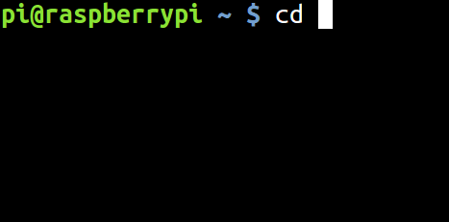

Changing Directories: cd
In order to move around between directories, you use cd for change directory.
You can give cd relative paths, like so:
Remember that ".." is a shortcut for "the directory above this one".
You can also use an absolute path, like so:
Notes:
In order to move around between directories, you use cd for change directory.
You can give cd relative paths, like so:
Remember that ".." is a shortcut for "the directory above this one".
You can also use an absolute path, like so:

Slide 21
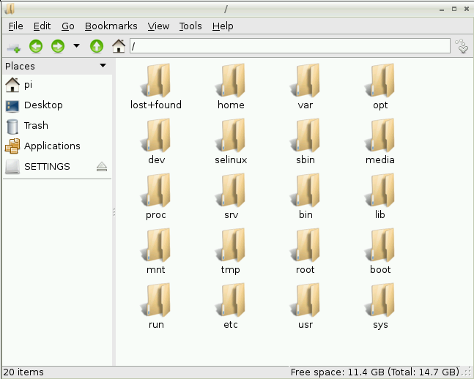
Remember that / is the root of the filesystem, the top-level directory under which everything else is nested.

Slide 22
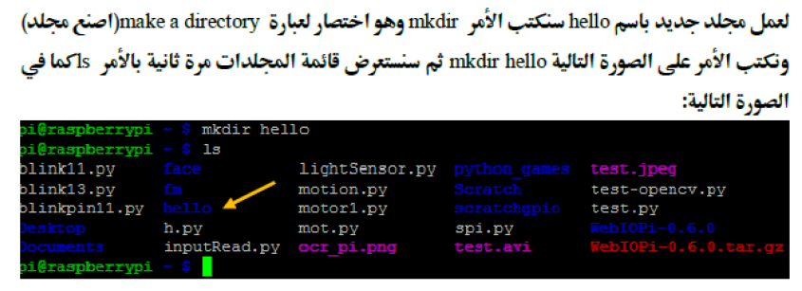

Creating Directories and Files: mkdir and touch
Mkdir

Slide 23

touch
Suppose we want to add a hello.txt to that directory?

Slide 24
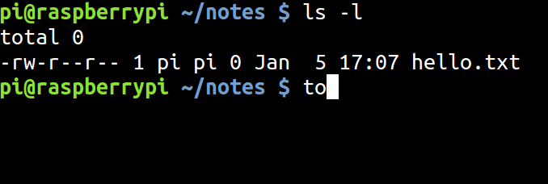
touch doesn't put anything inside that file. It just creates it.
There's one other thing to know about touch : If you run it again a bit later on the same file...

Slide 25
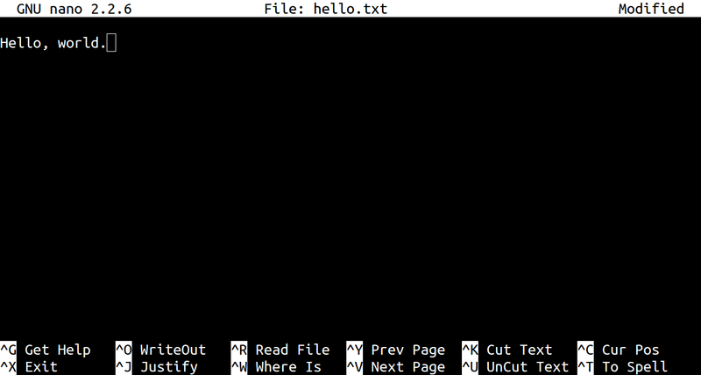
Editing Files: nano
nano is a little text editor.
You can think of it as something like a terminal version of Windows' Notepad.

Slide 26

The great thing about this interface is that it tells you exactly what to do. The bottom two lines of the screen are a cheatsheet for the most commonly used commands.
Just remember that ^ stands for "press the Ctrl key at the same time as". Ctrl-X will quit, Ctrl-O will save a file, etc. It doesn't take long to memorize these, but it's nice not to have to guess.

Slide 27
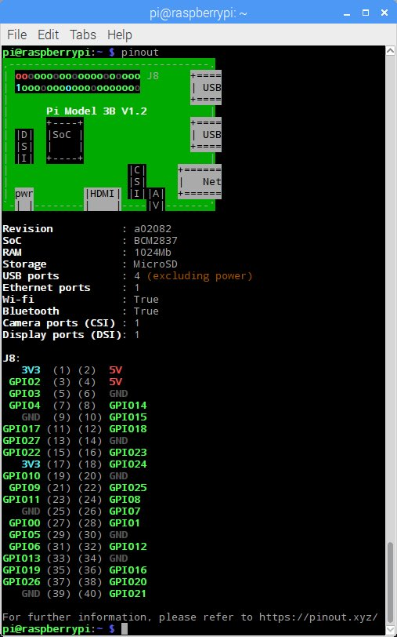
pinout

Slide 28
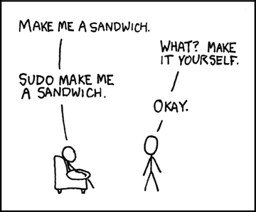
sudo
Cd /
Mkdir aa
Sudo mkdir aa
Cd aa
Ls
Touch aula.text
Sudo touch aula.text
Ls-l

Slide 29
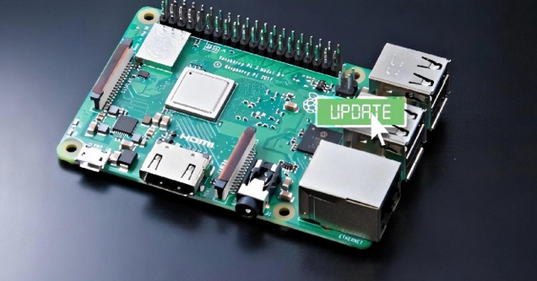
sudo apt-get install program name
How To Update Raspberry Pi
2022
sudo apt update

Slide 30
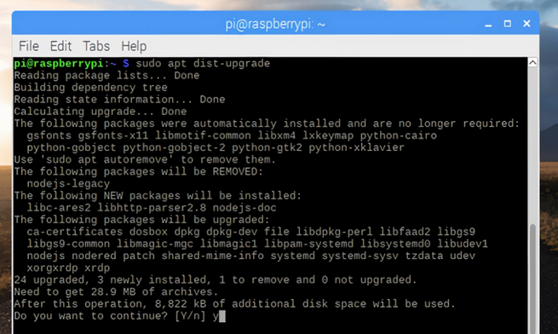
2022
sudo apt dist-upgrade
Notes:
https://jamesjdavis.medium.com/how-to-update-raspberry-pi-just-follow-these-easy-steps-ac507cf70238

Slide 31
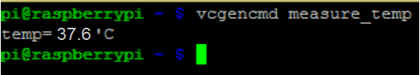
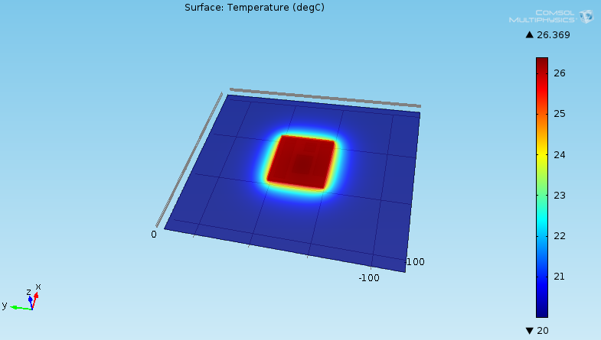
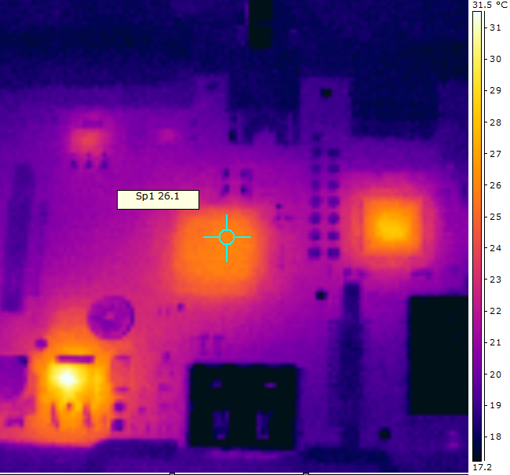
ملاحظة:
قياسات الحساس الداخلي للمعالج
المحاكاة في برنامج Comsol Multiphysics
عمليات تصوير حراري للوحة Raspberry Pi
Notes:
وللتأكيد على دقة النموذج التفصيلي المصمم قمنا بمقارنة النتائج التي حصلنا عليها من عمليات المحاكاة الحرارية مع القياسات الحرارية المستنتجة من الصور التي تم التقاطها باستخدام الكاميرا الحرارية
وكذلك مقارنة نتائج عمليات المحاكاة الحرارية مع قراءات الحساس الداخلي لشريحة BCM2835
الصورة الظاهرة لتجربة بدون مروحة بعد الاقلاع

Slide 32
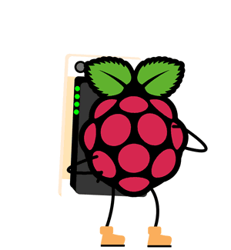
حاول تجريب باقي الأوامر الواردة في ملف التجربة المرفقة

Slide 33
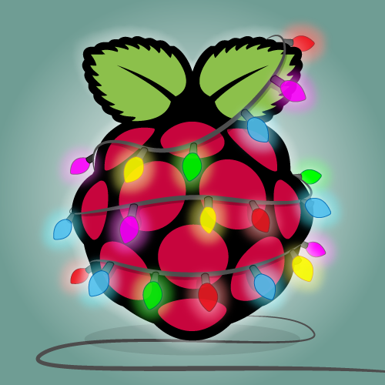
Thank You
Aula Jazmati

